Slide 1
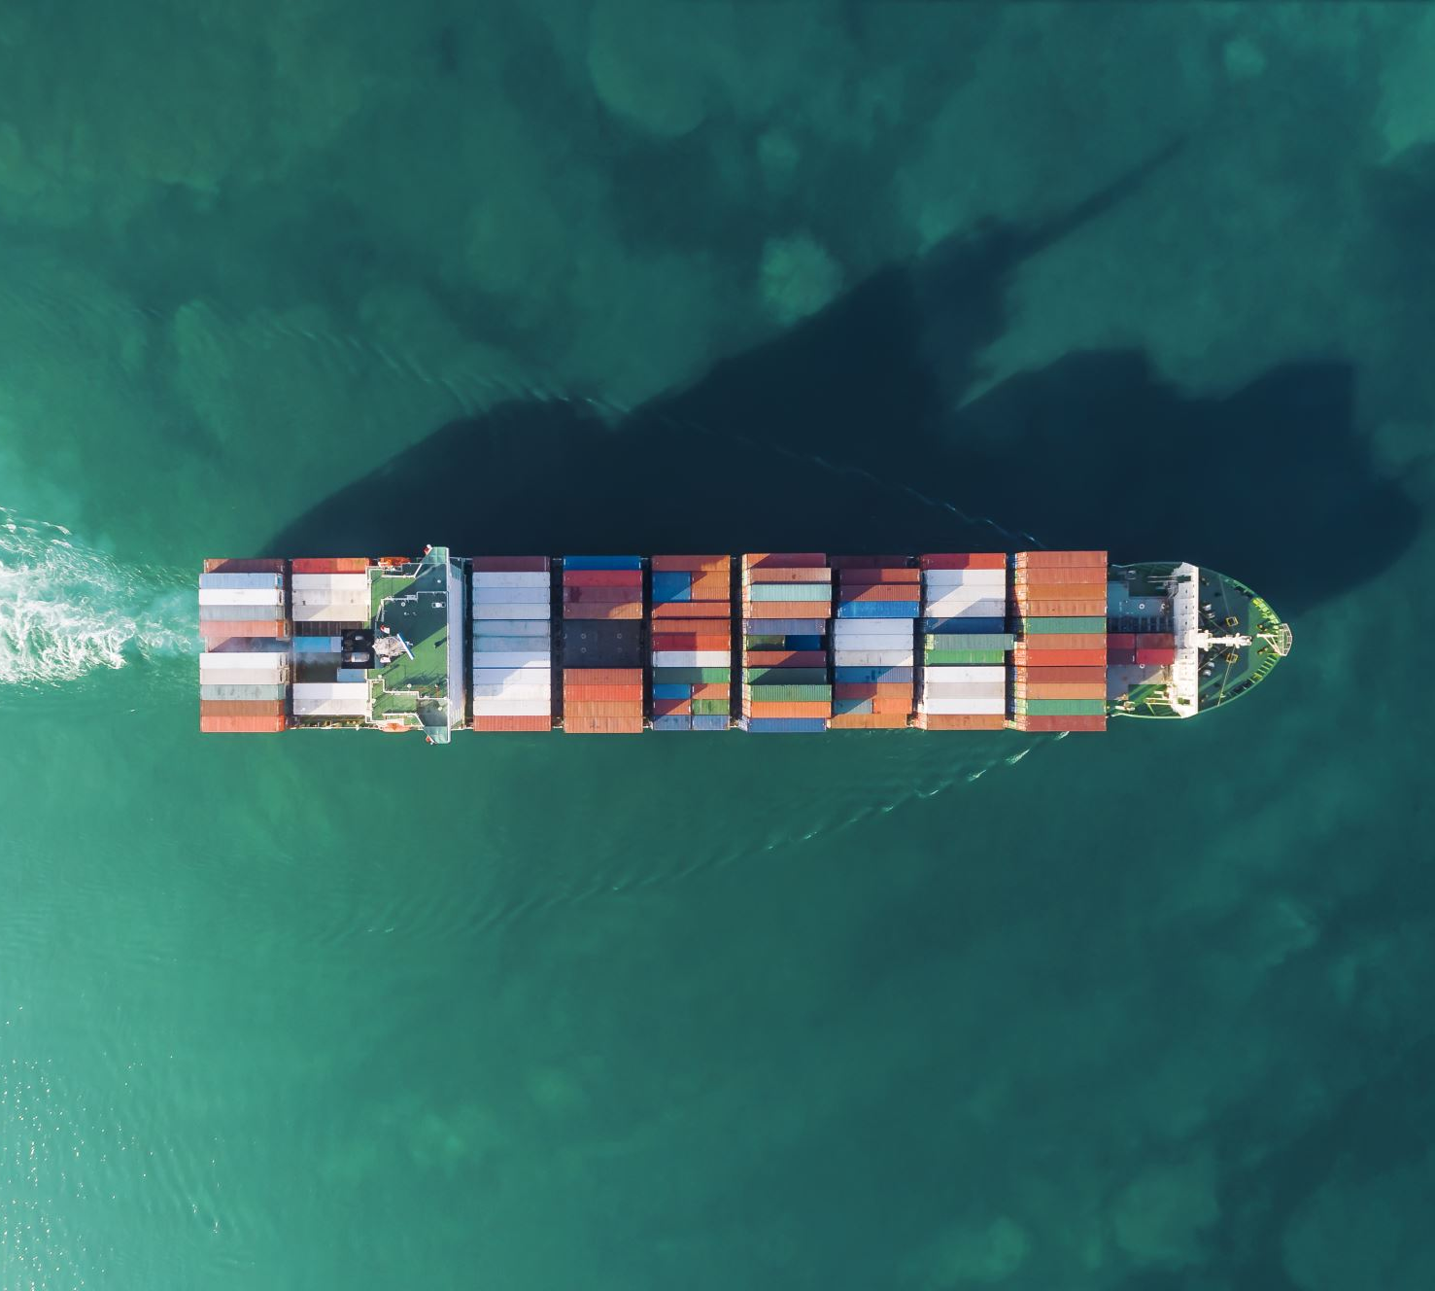
Analyzing Ocean Carrier Alliances
Transportation Research Group
School of Economic Sciences
College of Agriculture and Natural Resource Sciences
[WSU LOGO HERE]

Slide 2
What are Ocean Carrier Alliances (OCAs)?
Cooperative agreements between maritime freight carriers
Allies share capacity
e.g., Maersk will carry some cargo for Mediterranean and vice versa
OCAs allow carriers to offer additional services (e.g., additional lanes) and more efficiently allocate capacity.
The impact on shippers/consumers is not well studied.
For example, carriers sometimes offer very low prices on otherwise-used capacity in order to minimize empty haul. Under an alliance agreement, this capacity might be sold at normal prices to another carrier.

Slide 3
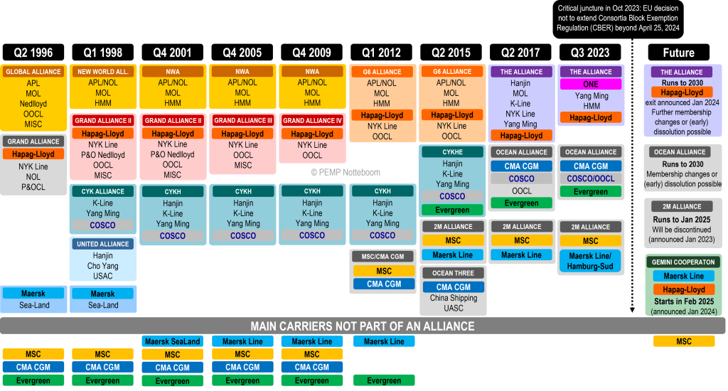
A Brief History of Alliances
Source: Theo Notteboom, PEMP

Slide 4
Do OCAs Reduce Competition?
Carriers argue that the increased efficiencies help keep costs down and allow them to provide better service.
Shippers and regulating bodies are concerned that OCAs give carriers too much market power
Anecdotal reports from US producers include high prices, reductions in frequency of service, and reduced delivery windows

Slide 5
Antitrust Exemptions
Both US and EU have historically agreed that OCAs are a net good:
European Union’s Consortia Bloc Exemption Regulation (EU CBER) exempted OCAs from most EU antitrust rules
US regulates OCAs via the Federal Maritime Commission (FMC) rather than applying traditional antitrust regs
This tide may be changing
EU Consortia Block Exemption Regulation expired on 25 April 2024
US Congress is considering similar regulation changes
e.g. the Ocean Shipping Antitrust Enforcement Act

Slide 6
WSU Transportation Research Group
USDA Grant
This research is supported by the U.S. Department of Agriculture, Agricultural Marketing Service. The findings and conclusions in this publication are those of the authors and should not be construed to represent any official USDA or U.S. Government determination or policy.
Investigating impacts of OCAs on Containerized Ag Exports
Price
Quality of Service
Service Frequency (number of voyages, total capacity)
Competitive Options (number of carriers servicing a given lane)

Slide 7
Data Sets
S&P Global’s PIERS database
Bill of Lading level data including volume, date, arrival and departure ports, commodity codes, vessel IDs (IMO codes), etc.
Dataset captures all maritime containerized freight bills processed by US Customs since 2005
~179M import bills, ~70M export bills
Alliance Membership Data
Referencing the work of Port Economics, Management and Policy’s Theo Notteboom
Future analysis will include Drewery’s Container Insights price data
Average prices per TEU for a given lane and month

Slide 8
West Coast Exports
Since we are initially focused on the impacts of OCAs on US producers and this is PNREC, this presentation presents data from US West Coast ports only.

Slide 9
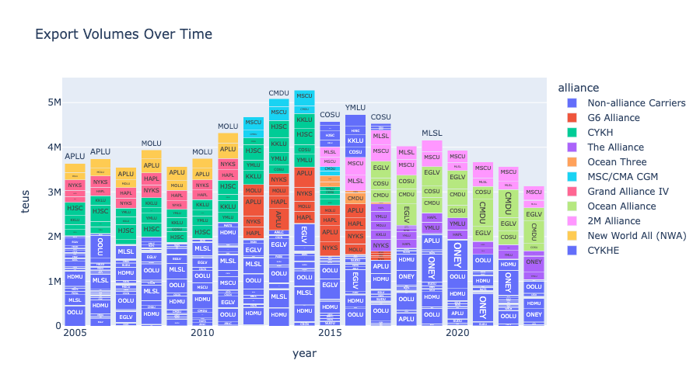

Slide 10
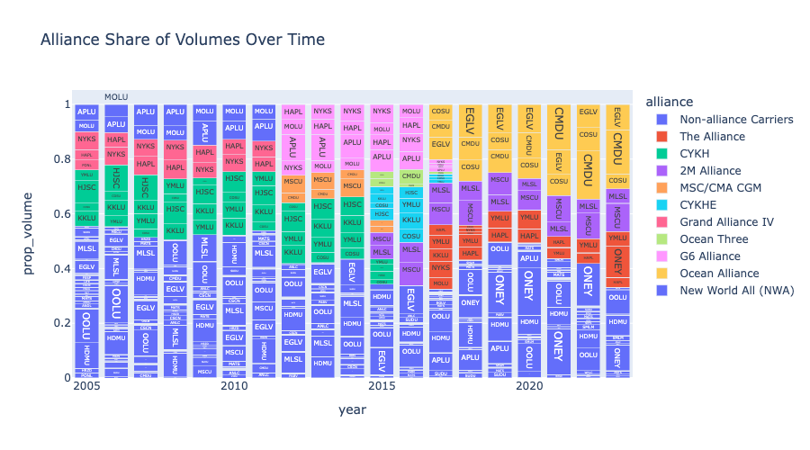

Slide 11

Measuring OCA Utilization
OCAs are not utilized on all lanes
Impacts of OCAs on a given lane should be proportional to utilization
We are developing a metric for OCA utilization based on cargo sharing behavior
$$Alliance Utilization = \frac{Capacity Shared with Allied Carriers}{Total Capacity Shared}$$

Slide 12
Cargo Sharing
We define a vessel’s ”Primary Carrier” as the carrier representing the most cargo carried on that vessel in any given month.
“Shared Cargo” is the cargo carried on a vessel not from the primary carrier.

Slide 13
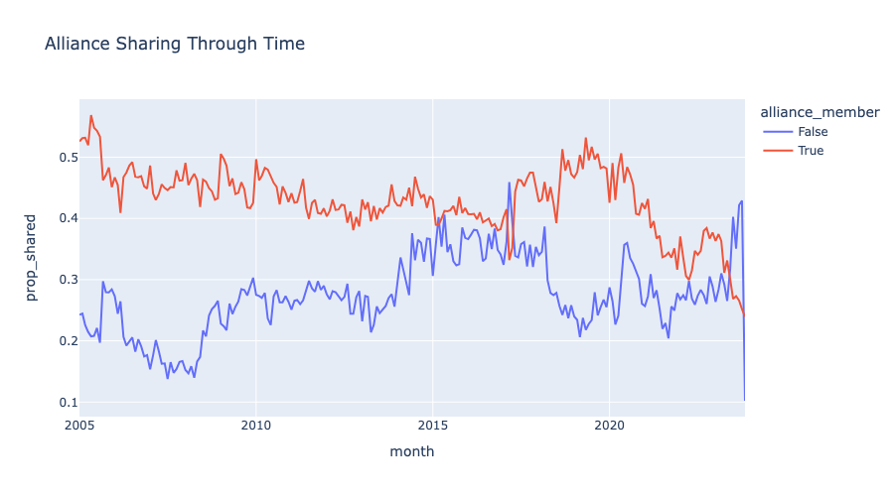

Slide 14
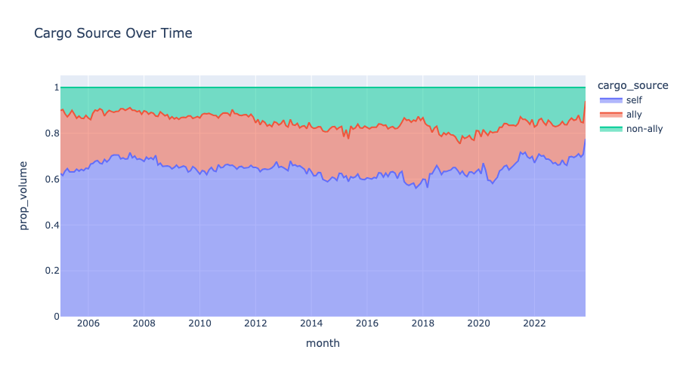

Slide 15
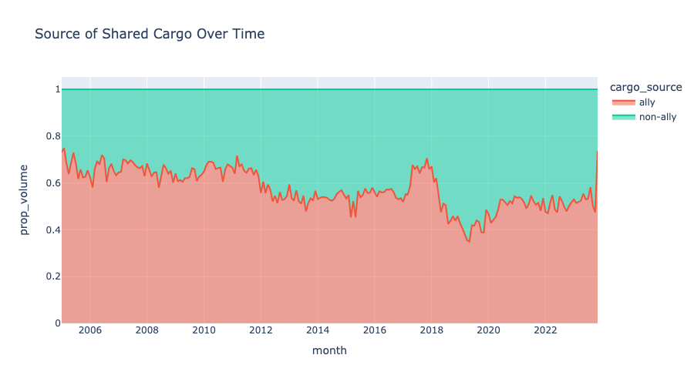

Slide 16
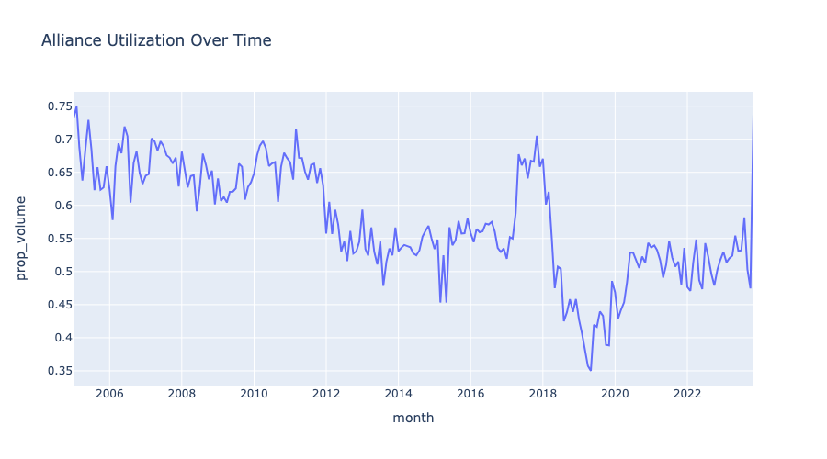

Slide 17
Limitations
OCAs are only one form of vessel sharing agreements (VSA); we do not observe any other form of VSA.

